Slide 1

Internet Voting: Some Considerations
Sean Murray
November 5. 2021
Notes:
For the past several years, as I’ve gone about my daily work at the Office of the Information and Privacy Commissioner, I have been gathering research on the subject of internet voting, anticipating that it may eventually be proposed in this jurisdiction. I wanted the Commissioner’s Office to be ready to participate in any opportunities for dialogue prior to any such initiative being implemented. In the winter and spring of 2020 I was afforded the opportunity to draft a White Paper on the subject, touching on the highlights of the research I had amassed. That paper is available at www.oipc.nl.ca on the main page of our web site.

Slide 2
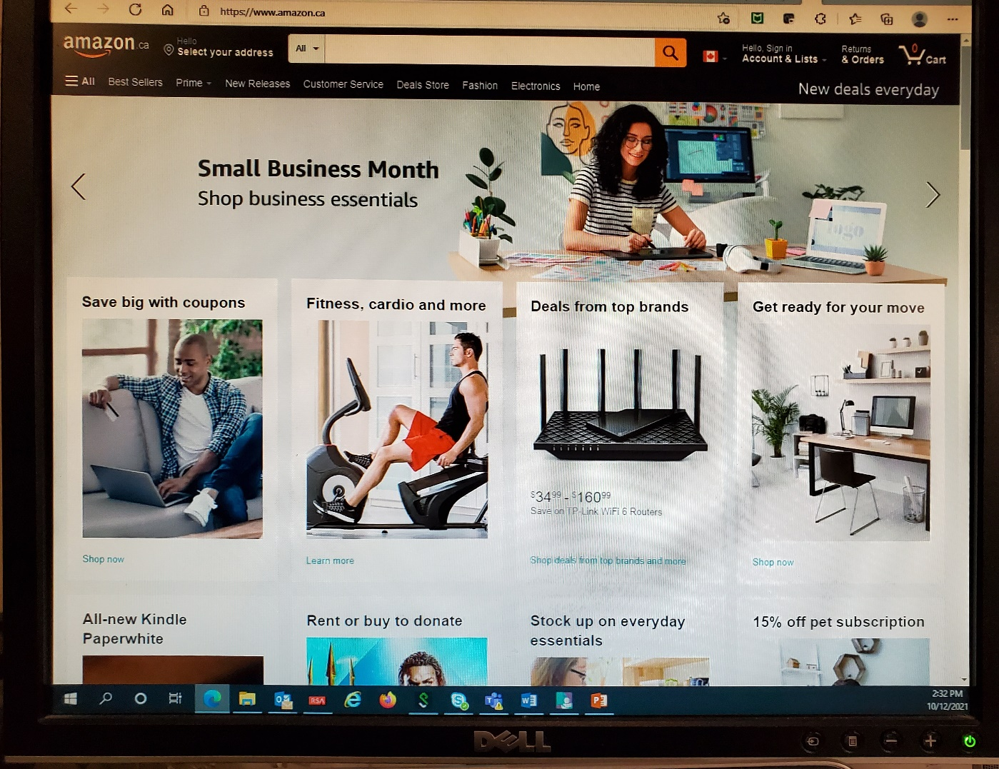

Slide 3
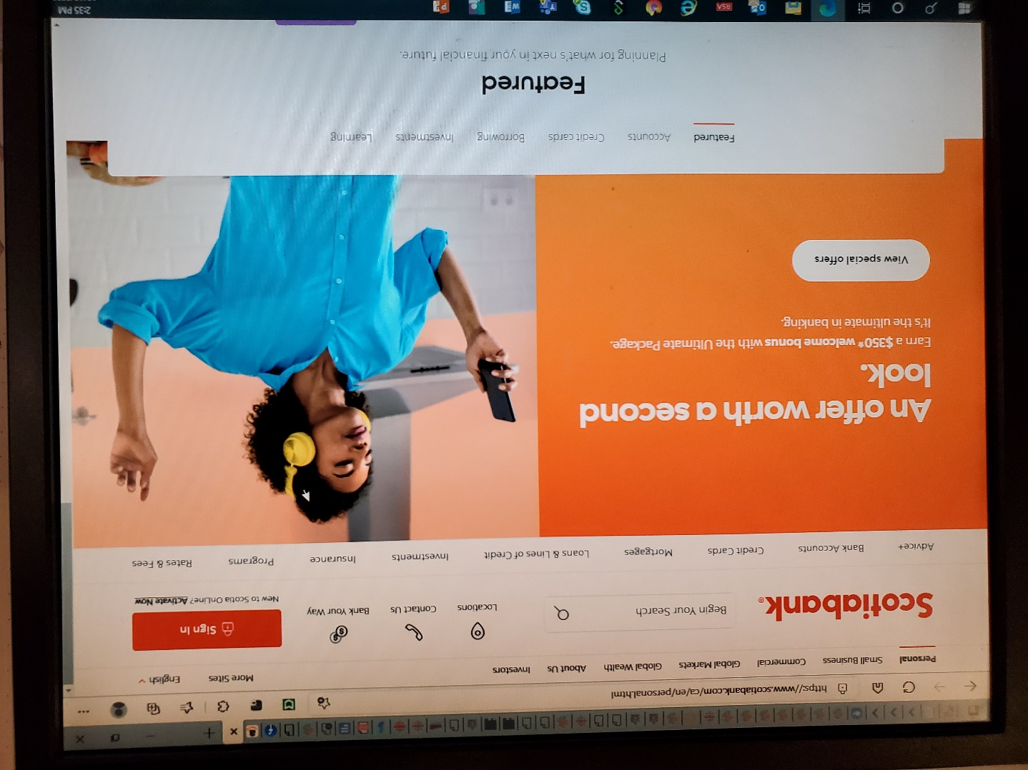

Slide 4
Today We’re going to talk about …
The Secret Ballot: What is it, and why is it important?
Online voting: The Catch-22
Case Studies: District of Columbia mock election via internet voting & the first comprehensive study of online voting in Ontario
Who else has studied the security of online voting? What have they found?
Does online voting increase voter turnout?
Does online voting comply with ATIPPA, 2015? A policy framework to consider the merits of online voting.
Other considerations (voter engagement; pandemic voting, why is internet voting “okayish” sometimes and not others, what is “appropriate technology” etc.)

Slide 5
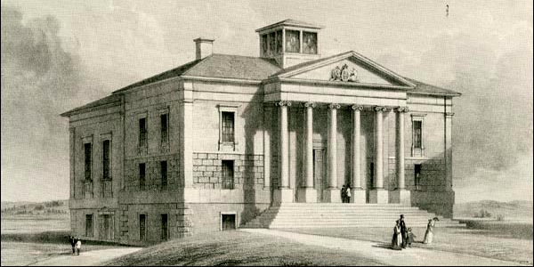
The first general election took place in the fall of 1832. There was no secret ballot. Individuals had to declare their vote in public at a polling station. This left voters vulnerable to intimidation or bribery. Fish merchants, clergy and others could easily use their influence to affect election outcomes.
https://www.heritage.nf.ca/articles/politics/history-of-vote.php

Slide 6
The Secret Ballot – an Innovation in Democracy
It was first introduced in Newfoundland in 1887. Prior to that, elections had been marked by violence, controversy, and disputes over election outcomes.
Since the late 19th century, the secret ballot has been accepted throughout democracies around the world as a fundamental element of the electoral process.

Slide 7
Verifiability and Anonymity – the two key ingredients of the secret ballot
Verifiability means there is a way to verify that you are an eligible voter, and that the vote you cast is your own vote, accurately recording your choice. In-person, paper ballot voting ensures this when you are checked against the voters list, given a ballot, go behind a partition to mark it, and place it in the box, all under the supervision of an election official, who cannot see how you have voted.
Anonymity means that once the ballot goes in the box, there is no way to trace it back to you personally.

Slide 8
shopping online isn’t anonymous
In shopping online, there is a record of the transaction at both ends – what did you buy, what did you pay for it, etc. You have a receipt – a record that the money left your account and was received by the vendor, who has your name and credit card information. It’s fully verifiable, but it’s not anonymous – commercial transactions don’t work that way.

Slide 9
The secret ballot means there should be no Record that ties your vote to you
An internet voting system can be verifiable. It can be designed to prevent fraud by making sure that the vote you entered on your home computer, laptop, or smart phone is the same vote that is tallied in the voting system’s database. In order to do that, there has to be an electronic trail of breadcrumbs, leading back to you. It can’t be completely anonymous.
An internet voting system can be completely anonymous, but in doing so, it can’t be verifiable. If it’s completely anonymous, there is no way to reconnect you to your voting choice. That means it is no longer verifiable.

Slide 10

You Can’t fly on one wing

Slide 11
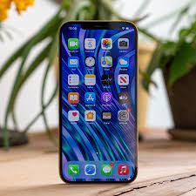
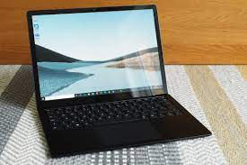
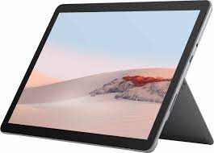
How much would you wager that your smart phone, laptop or tablet are Secure?
When it comes to security and privacy breaches, even the biggest companies in the world know it’s a case of when, not if, they experience a major breach, whether as a result of a malicious hack or simply an undiscovered bug. Not all breaches are actually discovered.
Notes:
How many times have you heard about a vulnerability that has existed in a product for years and they’ve just discovered it? Or a major hack that is only discovered months or years later?

Slide 12









Every Company gets hacked eventually
Sources: https://finance.yahoo.com/news/15-biggest-companies-hacked-173043357.html https://www.cnbc.com/2019/12/23/the-10-biggest-data-hacks-of-the-decade.html
Notes:
How secure is the internet? Ask these companies. Apple was hacked by a 16 year old from Australia – hacked into Apple’s servers, accessed 100 gigs of data. Why would anyone want to hack a municipal election? How many computer security attacks do you think the Government of Newfoundland and Labrador fends off every year? 10? 25? 100? 1000? Millions. Millions each year. Because its easy. Hacking is a low effort, high volume activity. Once you go online, you are entering into a permanent arms race, except you have no real proof, other than their assurances, that the vendor is up to the job of defending you.

Slide 13

When belief in the integrity of electoral systems is undermined, bad people like it
Notes:
In the US, Trump has taken a mostly secure voting system and undermined public confidence in it through fraud allegations. Election officials and courts, through judicial recounts and audits, have demonstrated that those allegations are false. What happens when the voting system is essentially a black box, and all election officials can do is say “we trust our vendor, so should you?”

Slide 14
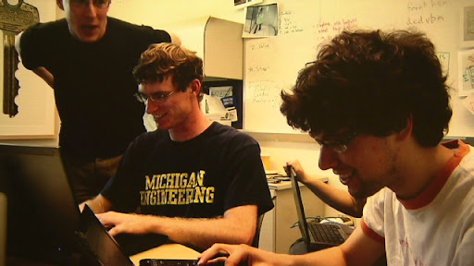
District of Columbia Mock election to test internet voting
University of Michigan students and their Professor, Alex Halderman, accepted the challenge. The voting system was hacked and the results completely compromised. They did it WITHOUT election officials realizing it.

Slide 15
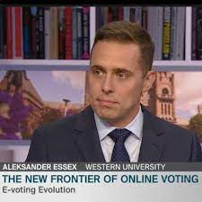
Northwest Territories’ last election was held online
Computer security expert Aleksander Essex from the University of Western Ontario wrote about it. He said the election process relied on foreign cloud service providers who potentially had “privileged access to see and change your vote.” He said that the legitimacy of the election relied on trusting that cloud provider. https://whisperlab.org/blog/2019/Online-Voting-Proxying-Comes-to-Canada

Slide 16
If Ontario municipalities can vote online, that means it’s totally fine, right?
In the first ever study of its kind, computer security experts studied every municipality in the 2018 Ontario Municipal Election. They found:
up to 50% of the online voters in the 2018 election were uniquely re‐identifiable;
no technical standards currently exist within Canada for designing, testing, or certifying online voting systems, nor auditing or otherwise independently verifying the result they produce;
no disaster preparedness: the clerk of Sarnia acknowledged, “I don’t have a disaster plan in place right now, I’d have to talk to my vendor about that.” The clerk for St. Thomas added, “We’re hoping nothing does happen.” 43 municipalities had to declare an emergency and extend voting by up to 24 hours in response to technical issues.
Source: https://whisperlab.org/ontario-online.pdf

Slide 17
Ontario Election Study, continued
the authors noted there was no opportunity for an independent security review, and “This fact is troubling, as we found numerous municipal documents in circulation which made security claims which were short on detail; mostly non‐technical; and largely unverifiable by members of the public.”
there appeared to be little objective evidence either supporting or disputing a particular online election result beyond the clerk’s declaration of results itself. The clerk determined the winner by simply logging into the vendor’s web site.
“For several months after the election, we received phone calls from council candidates from around the province asking how they could verify the correctness of the online vote totals. Many of them had experienced an unexpected loss, and although they all acknowledged there were entirely legitimate possible explanations for the outcome, they were understandably in search of answers.”

Slide 18

The BC government commissioned an independent panel to study online voting
The Panel’s number one recommendation in its Report was that internet voting should not proceed at either the municipal or provincial level. The Committee concluded that “[t]here are significant risks to implementing Internet voting that can jeopardize the integrity of an election, no matter the extent of implementation.”
https://elections.bc.ca/docs/recommendations-report.pdf

Slide 19
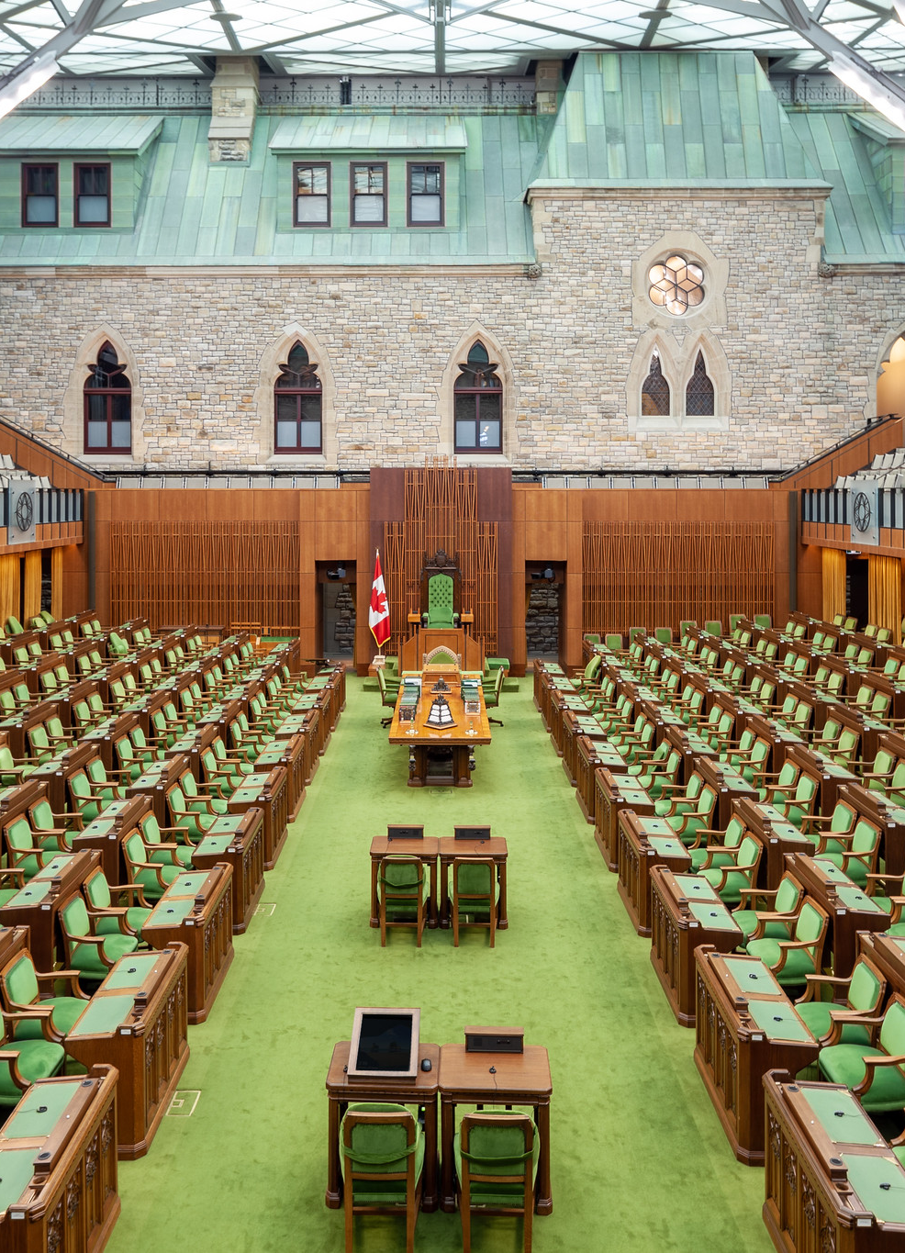
the House of Commons Special Committee on Electoral Reform Devoted a chapter to internet voting in its 2016 report
“The Committee acknowledges that many Canadians are open to the idea of online voting as a way of making voting more accessible. However, both supporters and detractors of online voting agree that the secrecy, security, and integrity of the ballot and the federal electoral process are fundamental. The Committee heard significant testimony … particularly from experts in technology, that the secrecy and integrity of an online ballot cannot be guaranteed to a sufficient degree to warrant widespread implementation in federal elections. The Committee agrees.”
https://www.ourcommons.ca/DocumentViewer/en/42-1/ERRE/report-3/page-267

Slide 20
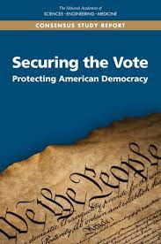
The US National Academies of Sciences, Engineering and
Medicine produced report in 2018 regarding the use of technology in elections called “Securing the Vote: Protecting American Democracy.”
At the present time, the Internet … should not be used for the return of marked ballots. Further, Internet voting should not be used in the future until and unless very robust guarantees of security and verifiability are developed and in place, as no known technology guarantees the secrecy, security, and verifiability of a marked ballot transmitted over the Internet.
Source: https://media.carnegie.org/filer_public/34/9d/349d3207-d994-4838-8b79-5f8d88e0e412/nas_report.pdf

Slide 21
Does online voting increase voter turnout?
In my paper “Internet Voting – Privacy and Security Risks” I noted overall voter turnout in recent Ontario municipal elections.
2014: 43%
2018: 38.29% (45% of municipalities offering online voting, 33% no paper ballot option)
The Association of Municipalities in Ontario indicates that the lowest voter turnouts on record prior to this were in 1997 and 2003 when turnout was 40%. BC’s Panel on Internet Voting determined that the evidence for any impact on voter turnout from internet voting is “mixed at best.”
Source: https://www.oipc.nl.ca/pdfs/InternetVoting%E2%80%93PrivacyAndSecurityRisks.pdf

Slide 22
Making important decisions:
A policy framework
1) what is the problem to be addressed?
2) what are the causes of the problem?
3) what are some potential solutions?
4) are the solutions likely to be effective?
5) will the potential solutions cause other problems and are those other problems worse than the initial problem?
Notes:
This is based on a Charter of Rights framework called the Oakes Test - #1 – there is usually a vague statement here – “modernizing the voting system” – but what is the actual problem? Most commonly cited problems are voter accessibility and voter turnout. Didn’t have time to vote? Bullshit. Mail in voting will sort that out.
#2 – what are the causes of the problem – accessibility – people have certain disabilities, mobility issues, eyesight deficits; voter turnout – the causes may be voter apathy, lack of engagement, lack of understanding of municipal issues, etc.
#3 - let’s actually gather all of the potential ways of accommodating those voters who need assistance with accessibility, and let’s compare all of those in terms of effectiveness, such as advance polling, having election officials visit a person at home to assist them with their ballot. Turnout – maybe not everyone wants to vote. Should we try to make them? Maybe some people are not interested? Stat holidays on election day, chase the ace – everyone who votes gets entered in a prize draw, term limits – City of St. John’s some people feel that incumbents generally keep winning so what’s the point? #4 are the solutions likely to be effective? Let’s look at experience elsewhere… #5 – will the potential solutions cause other problems that may be worse than the initial problem? Internet voting – it’s not clear that it is a necessary solution to any problem, but even granting that it is one possible solution (among others) to accessibility, what other problems are we creating? Doubt in the outcome, doubt in the electoral process, creating actual privacy and security risks where none existed before; potentially impacting verifiability and anonymity of the vote, ie getting rid of the secret ballot…

Slide 23
Would internet voting comply with ATIPPA, 2015?
ATIPPA requires public bodies to take steps that are “reasonable in the circumstances” to protect personal information. In transit between the voter’s device and the server storing the vote, the voter’s choice is personally identifiable information. But how do we know what’s “reasonable in the circumstances?” In this case, the Supreme Court of Canada may assist us:
103 Maintaining confidence in the electoral process is essential to preserve the integrity of the electoral system which is the cornerstone of Canadian democracy. … [F]aith in social and political institutions, which enhance the participation of individuals and groups in society, is of central importance in a free and democratic society. If Canadians lack confidence in the electoral system, they will be discouraged from participating in a meaningful way in the electoral process. More importantly, they will lack faith in their elected representatives. Confidence in the electoral process is, therefore, a pressing and substantial objective.
Harper v. Canada (Attorney General)
Notes:
Would it comply with the Charter? While there have been challenges of the validity of internet voting in terms of whether it complies with provincial legislation (and these have not succeeded), no one to my knowledge has yet attempted a Charter challenge.

Slide 24
Other considerations
Voting accessibility
Appropriate technology – E.F. Schumacher
What can internet voting technology be used for? No secret ballot required (House of Commons remote voting); private organization – no public impact;
Permanent arms race
Public engagement
Addressing the actual challenges of democracy instead of starting with a solution in search of a problem
Notes:
20 years ago I ran for Council in St. John’s – I know what it’s like to knock on doors and ask people for their support. Democracy is important – it’s one of the most important things we have, collectively, in society. That’s why I’m here today – because it’s too important to take chances with, for little or no gain.

Slide 25
In Summary …
It makes voting more convenient for people who already vote;
It is one way of making voting more accessible to people with disabilities;
Evidence is lacking to support the assumption that it increases voter turnout over time;
There are fundamental security issues with internet voting that many computer security experts see as insurmountable.
In order to take on the additional risks that come with internet voting, the benefits would have to be quite substantial in order to justify those risks. The evidence to date is that the benefits are negligible or marginal, while the risks are substantial.
Notes:
Compare with electronic medical records.

Slide 26


